Slide 1
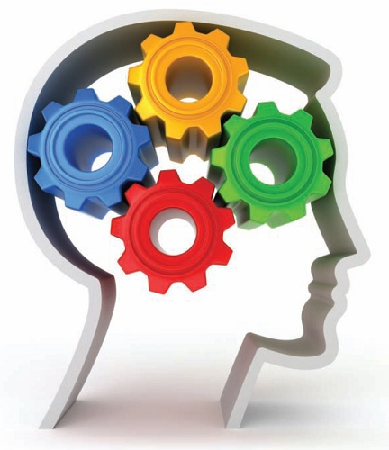







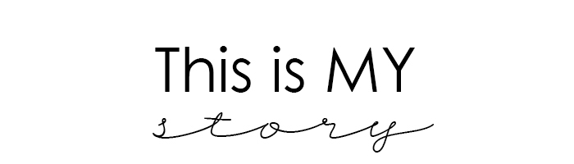


My
My
My
My
My
World
My

Slide 2







Every Monday we collapse our traditional timetable and curriculum so that all the children are taught together- sometimes in their year group but on other occasions in vertical house groups (Reception- Y6)
‘My Mondays’ are delivered by Teaching Assistants, our SENDCo- Mrs Howell, and our Headteacher- Mrs Ely. This allows all our teachers to plan and assess together in joint non-contact time. We explore things which are important to us and our community. The following slides give an outline of some of the things we cover.

Slide 3
My
My
Exercise
Relationships
Sleep
Eating and Food
Relaxation
Safety

Slide 4


My
My School
My Church
My Village
My County
My Country
My World

Slide 5
My
Respect
Responsibility
Thankfulness
Truthfulness
Perseverance
Friendship

Slide 6
My
I am curious
I am creative
I am unique

Slide 7
World
World
My
World
Environment
Conservation
Recycling
Wildlife
Diversity
Ethics and Dilemmas

Slide 8

My
Aspiration
Inspiration
Careers

